Slide 1
Anime Recommender
Hung Do, Matt McKenna, Ao Wang

Slide 2
Problem Statement
Viewers find themselves overwhelmed by the number of anime available.
How can we provide users with a set of recommendations that is customized according to their rating history?
Notes:
Viewers often find themselves overwhelmed by the sheer number of anime choices available.
The challenge lies in creating a recommendation system that not only navigates through this extensive catalog but also provides personalized recommendations to suit individual tastes.
We want to build a system that is capable of discerning nuanced preferences and delivering anime movie and TV show recommendations that resonate with the viewer's unique profile and ratings.

Slide 3
Data Description
Name | Description | Example
Ratings Dataset
user_id | Non-identifiable randomly generated user id | 2
anime_id | The anime that this user has rated | 11771
rating | Rating out of 10 this user has assigned (-1 if the user watched it but didn't assign a rating) | 10
Anime Metadata
anime_id | Myanimelist.net's unique id identifying an anime | 1
name | Full name of anime | Sword Art Online
genre | Comma separated list of genres for this anime | Action, Adventure, Drama, Fantasy, Magic
type | Movie, TV, OVA, etc | TV

Slide 4
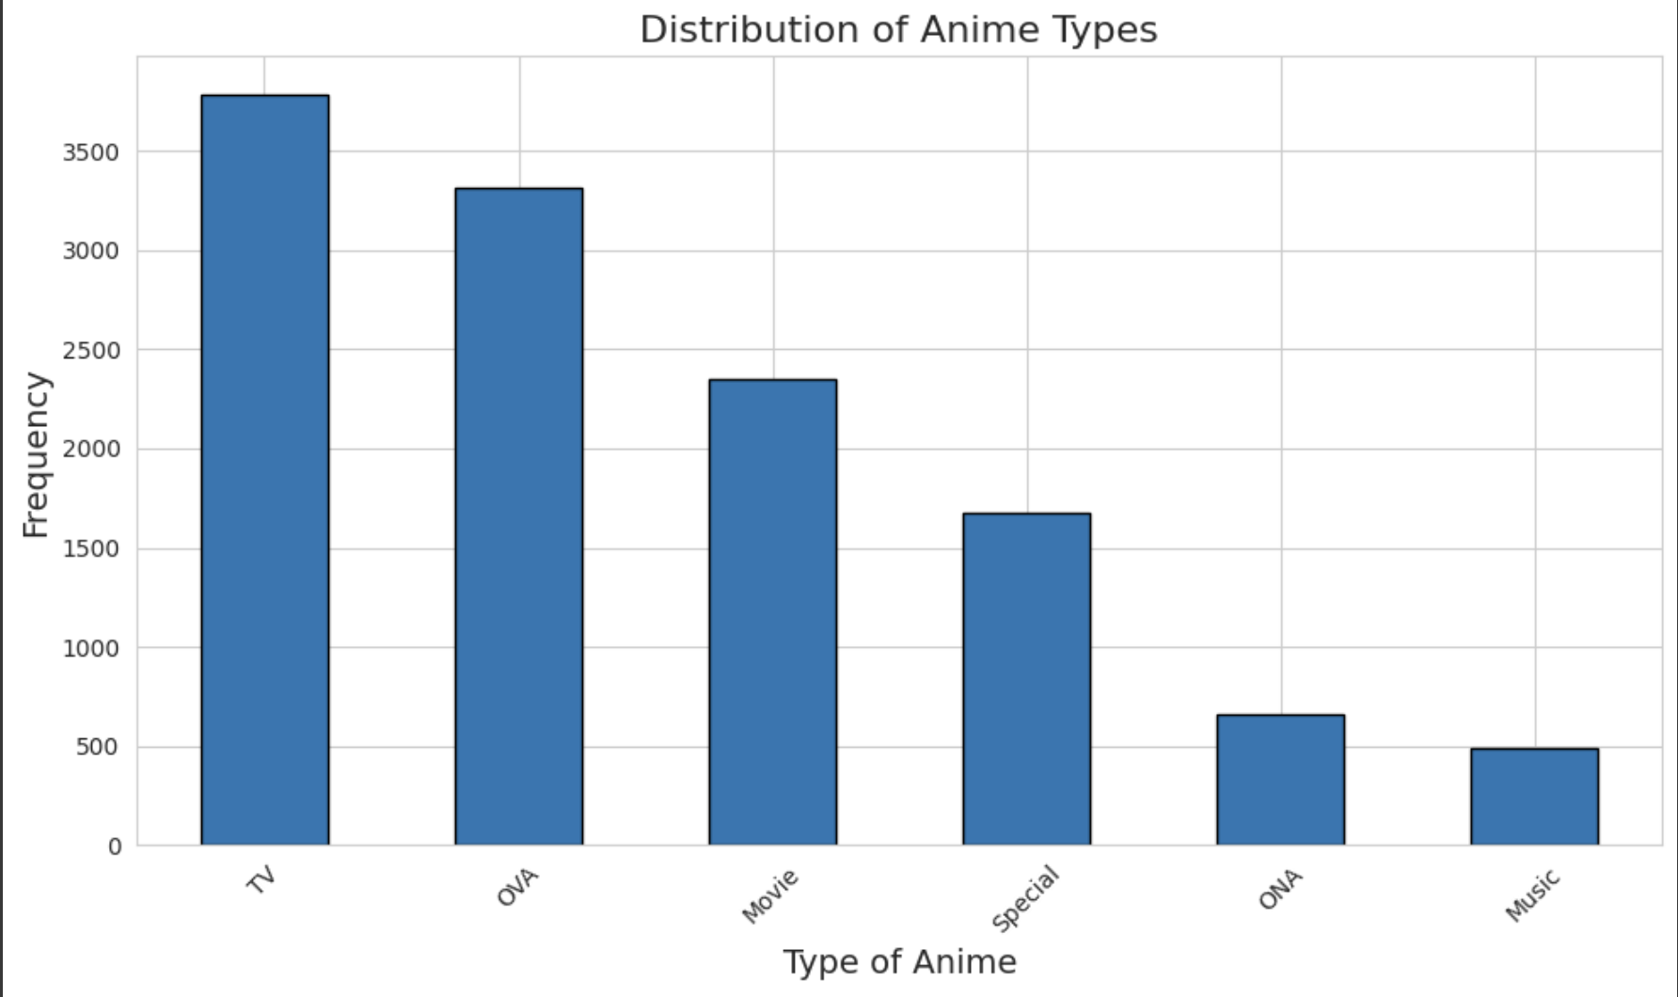
Experiment
Filtered music from the type of anime:
Different from TV shows, movies, ONA, OVA
Rating dataset:
90% train
5% test
5% eval

Slide 5
Algorithms
Baseline Models:
Popular
Lift
Implicit MF
Item KNN with Implicit Feedback
Content-based Model:
Primarily focused on genre w/ weighted ratings
TorchTag Model:
Use genres as anime tags

Slide 6
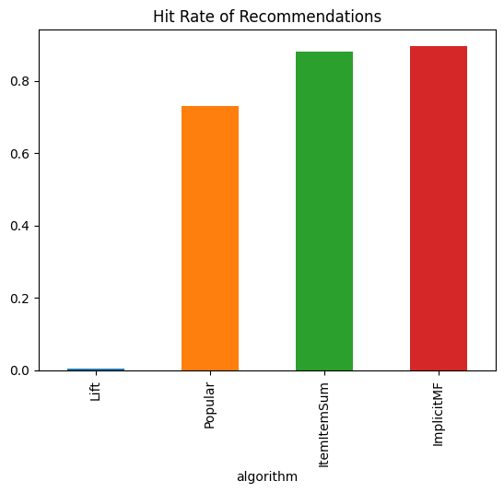
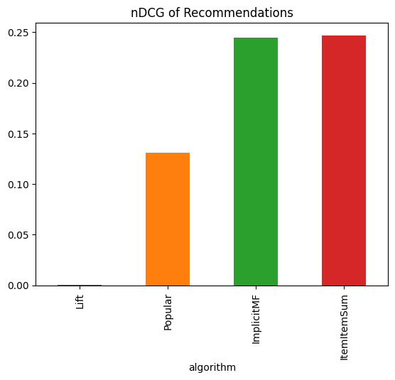
Baseline Models
Test the dataset with Popular, Lift, ImplicitMF, and Item-Item with Implicit Feedback
ImplicitMF and Item-Item with Implicit Feedback score relatively the same

Slide 7



Content-based Model
TF-IDF Vectorizer
Cosine Similarity
GenreRec Model
nDCG: 0.022
Hit Rate: 0.225

Slide 8
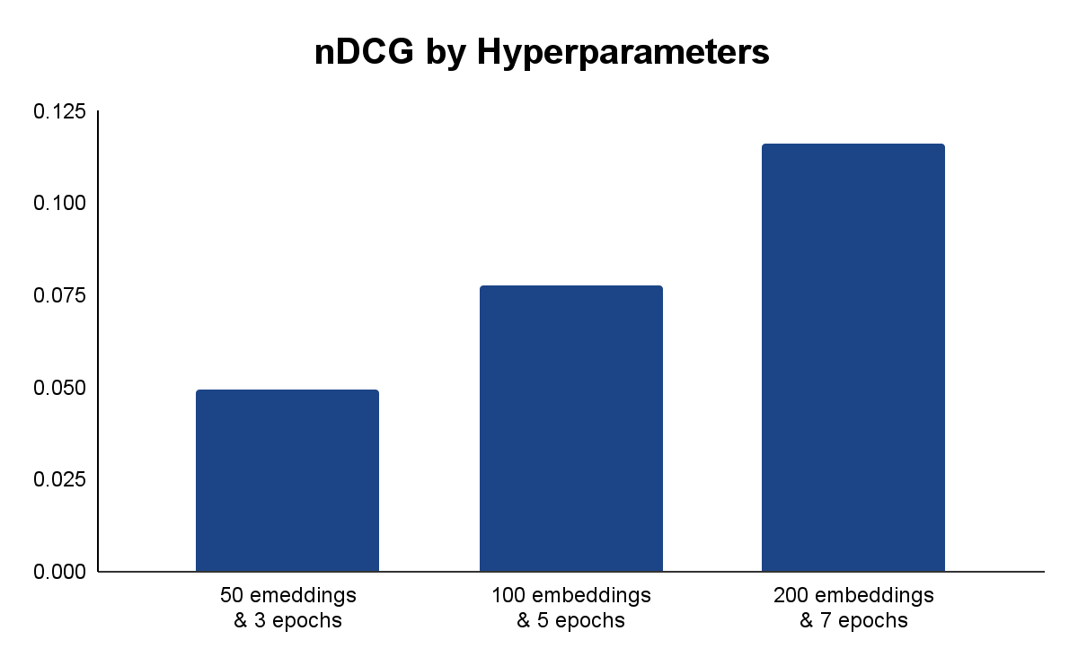
TorchTag Model
Animes have 1-5 genres, each of those were a tag for the Lenskit model
Tuning the hyper-parameters greatly improved the model outputs’ relevance

Slide 9
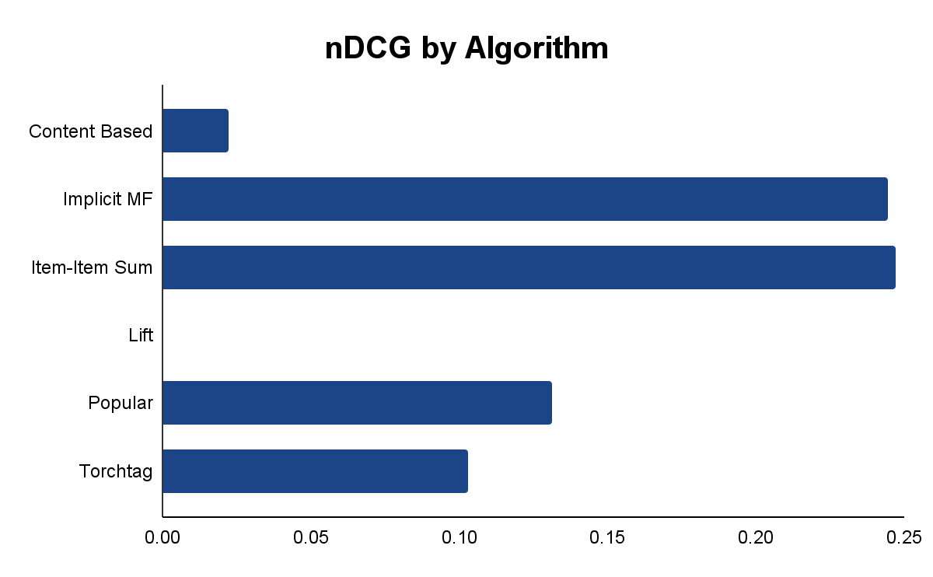
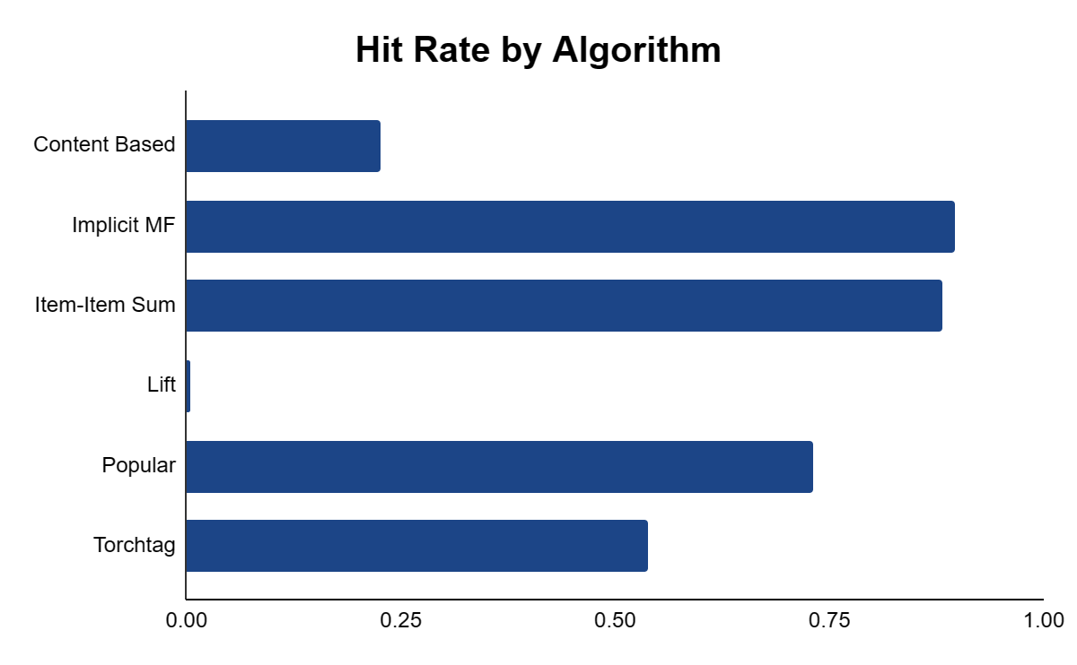
Results
We chose nDCG and Hit Rate to measure the relevance of our top 20 recommendations
We used the eval dataset, which our models hadn’t seen

Slide 10
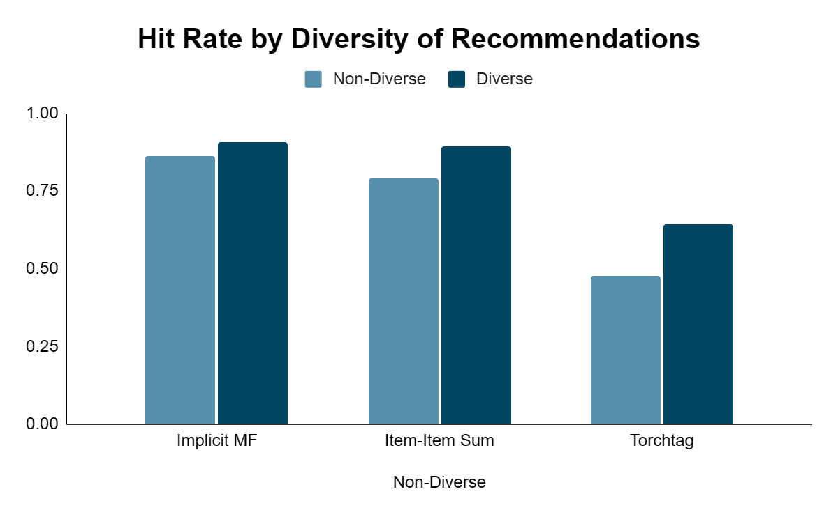
Diversity
We wanted to explore an additional evaluation metric
Diversity defined as the percent of recommendation sets where no genre is over 75% of the set
Content-based model was ~0% diverse; Lift and Popularity were ~100%

Slide 11
Reflection
Our evaluation was thorough as we attacked the problem from multiple angles
We were lucky to have a dataset that was clean and required minimal work
By applying multiple approaches we saw how different models produced dramatically different results
Thanks to Professor Ekstrand for clear instruction and the lenskit package

Slide 12
Thank you!

